Slide 1
Project Molecule MAY1739
Advisor: Arun Somani
Ryan Wade, Nathan Volkert, Daniel Griffen, Alex Berns
Notes:
E + RYAN

Slide 2
Project Molecule
Multi-Node Shared Application Environment
For Smart Home Systems
Notes:
RYAN

Slide 3
Purpose
Motivated by
Incompatible Smart Devices
Platform Handles
Networking
Security
Discovery
End User
Enthusiasts
3rd Party Developers
Notes:
RYAN
PM is motivated by the incompatibility of most smart devices on the market
Our platform aims to handle the networking, security, and discoverability of these devices through applications extending our system
The end users of our platform are enthusiasts and 3rd Party App Developers who will write applications to connect other smart devices or set up our system in their home.

Slide 4
System Concept
Notes:
ALEX
The system of project molecule consistes of several nodes, called Atoms. Each atom is in charge of the permissions and communication of the applicaitons they host.
The applications themselves each run on a seperate process. They perform actions of conencted devices, like lightbulbs and coffee makers.

Slide 5
Market Survey
Alexa
Voice Control IoT Via Skill API
Zigbee + BLE Mesh
Low Level Network Protocol
Google Home
Google Product Integration
Notes:
ALEX
Alexa
- Made by Amazon
- Control Interface only
- Could write an App to use Alexa to control PM
Zigbee + BLE Mesh
- Low Level networking protocols
- PM could use these as the communicaiton
Google Home
- Closed System of google products
- PM is communicty driven and open source

Slide 6
Deliverables
Runtime Binary
Stable API with Documentation
Application Creation Tools
Atom & System Configuration Tools
Operation Manual
Notes:
NAT
Tools will be provided to create 3rd party Applications
A stable API will be exposed and documented for 3rd party development
Tools will be provided to configure and manage Devices

Slide 7
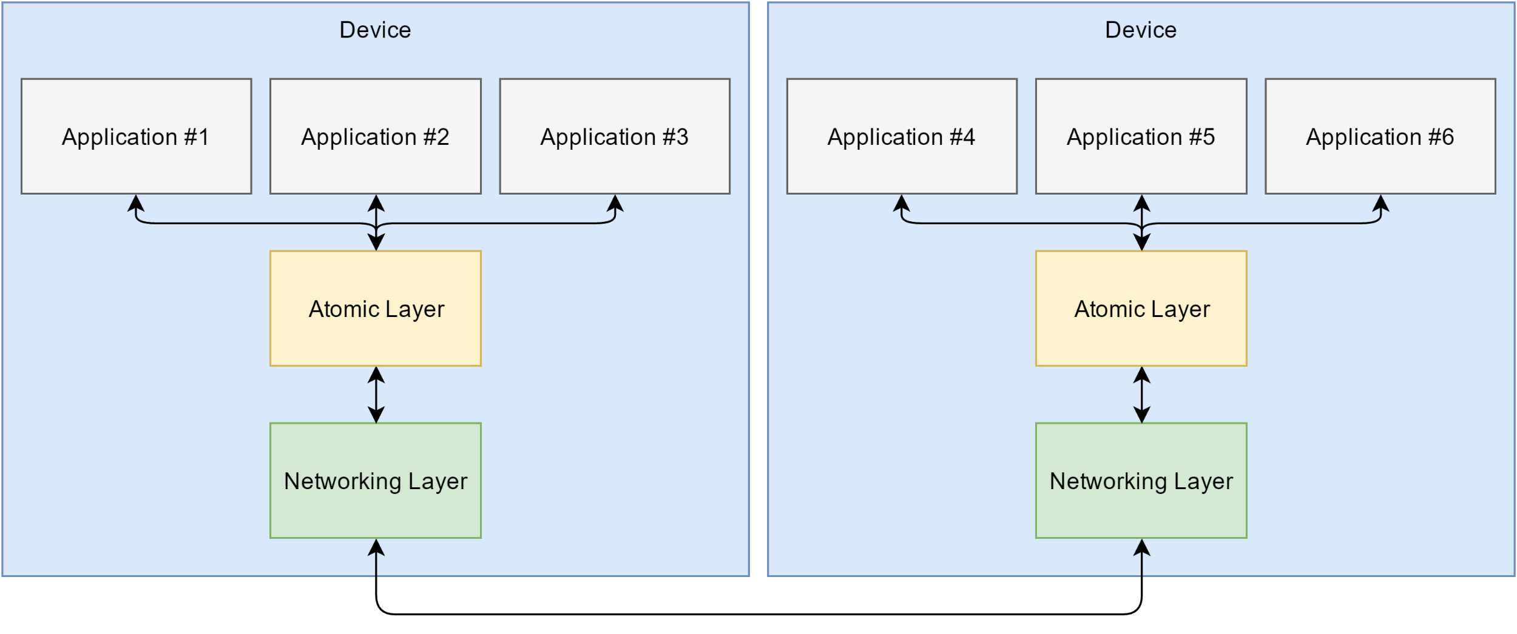
Specification – System Diagram
Notes:
NAT
Networking Layer
A full mesh connection between each atom which abstracts the routing.
Atomic Layer
Manages the lifecycles and permissions of an application on an atom.
Application Layer
3rd party binaries which add features or interface with external devices.
Communication
Uses Asynchronous Request-Response Pattern for internal communication.

Slide 8
Specification – Messages
Routing
Action
Payload
Stream (Optional)
Notes:
DAN
Messages contain routing, protocol data called an Action, a sized data payload, and an optional data stream. The optional data stream can be used to send large files or data chunks.

Slide 9
Specification – Routing
Messages Routing Criteria
Action Protocol
Application ID Filter
Atom ID Filter
Filters
Implicit – All, Any
Explicit – Some, One
Encryption & Handshaking
Error Notification
Notes:
DAN
* routing information is only processed on a request. This processing sets up a path for the data to return. Once a request has been received, the response follows this path back to the requestor.

Slide 10
Specification – Actions
Describe Features an Application Supports
Defines a Data Protocol
Allows Interoperability between Applications
Examples
SWITCH
FILE
COFFEE_MAKER
Notes:
NAT
Interoperability: Standard protocol to allow apps to communicate without knowledge of implementation
* Allows Apps to reason about the data or streams it will receive in a message
* FILE, SWITCH

Slide 11
Specification – Permissions
Restricts Message Passing based on
Source
Destination
Action
Types of permissions
Send – What you can Request
Receive – What Requests you can process
Broadcast – Implicit Application Destination
Applications must declare required permissions
Notes:
NAT
* routing information is only processed on a request. This processing sets up a path for the data to return. Once a request has been received, the response follows this path back to the requestor.

Slide 12
Specification – Non-Functional Requirements
Asynchronous
High Bandwidth, Minimal Latency
Fault Tolerant
Redundancy
Device Failure
Notes:
NAT

Slide 13
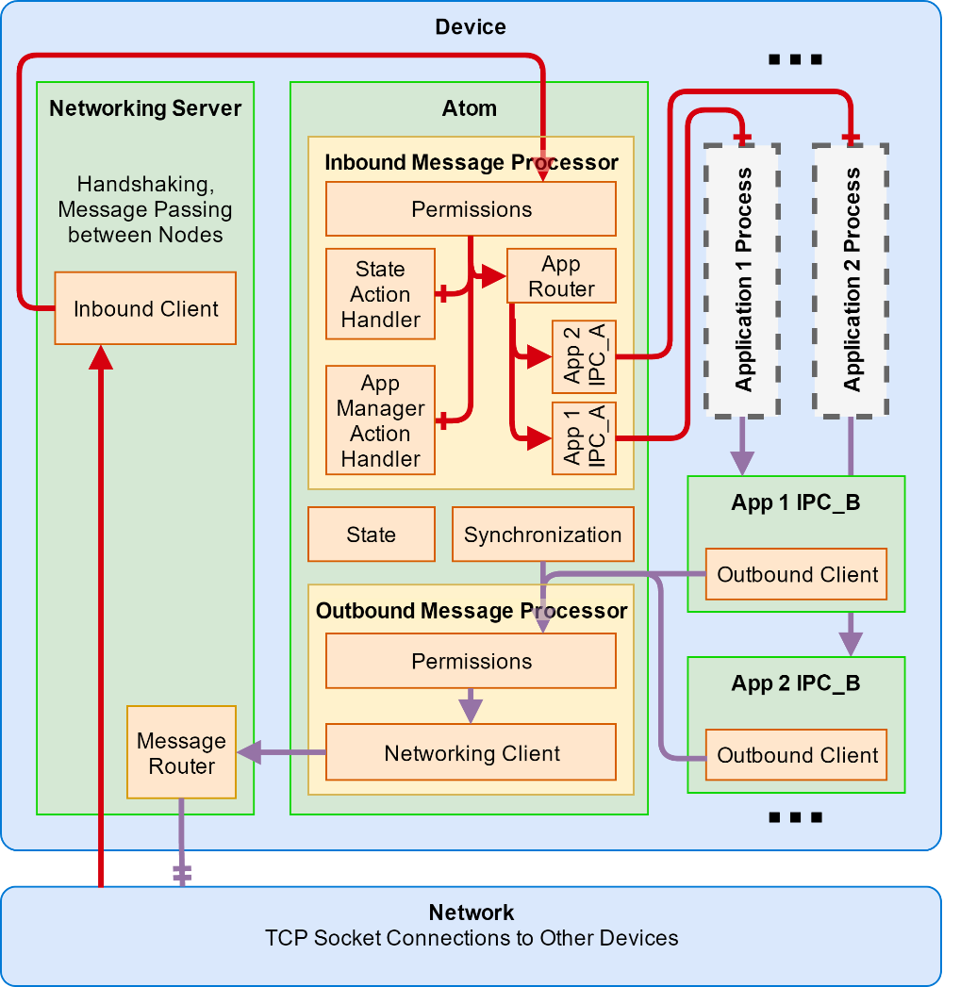
Design – Routing
Inbound Message
Forward to Atom
Permissions
Handler or App Router
Outbound Message
Permissions
Forward to Network
Message Router
Notes:
RYAN
Inbound + Outbound Messages
Inbound – from System
App Router – IPC
Outbound – from apps

Slide 14
Design – Action Handlers
State
Key Value Database
Accessible in Atom
State Action Handler
Accessible outside the atom
App Manager Action Handler
Manage Lifecycle Actions
Manage App Actions
Notes:
RYAN
State:
Accessible to modules inside Atom
Handler – Messages from Applications, Atoms, or the Network Layer
App Manager:
Manages lifecycle of Applications
install, uninstall - permissions
start, stop – app discovery
By managing the lifecycle in the atom, applications become unable to modify the lifecycle of other applications. This creates isolation and better security.

Slide 15
System Startup
Read Atom, Device, and Application Manifests
Setup Atom Communication
Capture Existing Service Discovery Information
Install and Start Local Applications
Notes:
RYAN
At Startup we know what Atoms are in the System. An atom only knows what Applications are installed or should run on itself.

Slide 16
Testing
Module
Rust Compiler
Other Testing
Integration
Logging
Tracing
Message Injection
Field
Run Example Applications
Stress Testing
Notes:
DAN
Module Testing
Success – State, Network, Permissions, Message, Crypto
Rust
Limitations – Didn’t have a good way to mock functionality
Advantages – Rust Compiler Integration Testing
Integration Testing
Logging
Message Injection
Field Testing
Running Example Applications

Slide 17
Testing – Non Functional Requirements
Latency
Message Routing Time
WSL - 17 ms
Linux – 1.3 ms
Bandwidth
Video Streaming Application
Fault Tolerance
Redundant Application Test
Notes:
DAN

Slide 18
Feedback – Developer Tools
Operation Manual
Added System Description
Step-By-Step Example
Command Line Interface
Clarified Prompts
Unintended Uses
Notes:
ALEX
While writting the operational manual and developer tools we took user feedback.
The operational manual helped users understand the actions they could perform to create a system but a basic description of the sytem and a complete example of operation.
The Command Line tools also had some feedback. While the op manual defined the tools and their prompts, in line clarification was requested. The users also helped discover unintended uses. For example, running the bundle command before creating the atom.

Slide 19
Design Decisions and Obstacles
Application Discovery & Routing
Naming Scheme
Feature Creep & Over-engineering
Notes:
ALEX
Application Discovery
- Originally stored in Network Layer
- Moved to Atomic Layer due to similarity to permissions
Naming Scheme
- Used chemistry terms to name system parts
- Names made it more difficult to descirbe system
- Networking and Applicaitons are now common terms
Feature Creep
- UI Server and Tird Party Applications
- Had to return to original scope

Slide 20
Investment
Fall 450
Spring 850
Total 1300 Man Hours
Notes:
NAT

Slide 21
Next Steps
UI Application
State Synchronization
Stabilize API
Abstract Network Protocol
Notes:
DAN

Slide 22
Q&A

Slide 24
ROUTING EXAMPLES
Action | Atom | App | Description
T | ALL | ALL | Broadcast message to all applications on all atoms which can receive Action T
T | ANY | ONE(id) | Routes a Message to an unspecified instance of the Application
T | ALL | ONE(id) | Routes a Message to all instances of the Application
T | ANY | SOME(ids) | Routes a Message to an unspecified instance of each application

Slide 25
